Slide 1
HW8 VER1 Presentation
Jacob Nelson

Slide 2
What you will find
-A robust time management system.
-A feature to add, and search data.

Slide 3

Feature 1 Time Format:
-This feature allows you to toggle time formats between AM/PM and 24 hour.

Slide 4
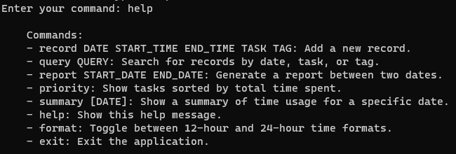
Feature 2help command:
-This feature allows you to always find a list of commands to use.

Slide 5
Lines of Code
327 Lines of Code total

